Slide 1
Lecture #13: Introduction to DBMS
CME2002 Data Organization and Management
Dr.Adil Alpkocak

Slide 2
The Database Management System
A Database Management System (DBMS) is the software medium through which the user accesses stored data
Three classes of database systems
Enterprise Database
Workgroup Database
Personal Database

Slide 3
The Relational Database Model
Relational DBMS is the foundation of most modern database i.e. Oracle, SQL Server, Access etc.
The relational database uses the concepts of attribute, domain, relation, tuple and primary key

Slide 4
Some technical jargon
The words in the same columns are synonyms.
Table | Row | Column
Relation | Tuple | Attribute
File | Record | Field

Slide 5
The Relational Database Model cont.
Attribute is a name or label for a set of data that refer to the same thing
Vendor_zip_code
Domain is a collection of non-decomposable individual units of data in a database
07055, 44830, 10027, 09098 is the domain of attribute Vendor_zip_code
Relation is the set of related attributes as defined by a user
If Vendor_ID and Vendor_name is defined by the user as a relation then the data set associated with this relation is
V110, Jersey Vegetable Corp.
V25, General Provisions
V250 Spices Unlimited
V75, Pasta Supply Inc.

Slide 6
The Relational Database Model cont.
Tuple is a set of related data from within a relation
V110, Jersey Vegetable Corp.
V25, General Provisions
V250 Spices Unlimited
V75, Pasta Supply Inc.
There are four tuples consisting of values for Vendor_ID and Vendor_name
Tuples are implemented as rows in relational databases
Primary Key is an attribute in which the domain value is unique
Vendor_ID may be used a a primary key

Slide 7
The Relational Database Model Viewed as a Set of Tables
An entity is a person, place, event or a thing about which information is to be kept in a database
Attributes are unique pieces of information associated with an entity.
A table is defined by an entity set and attributes it represents.
For example,
Table VENDOR maintains information about a set of suppliers for an enterprise.
Each of these suppliers is an entity.
Vendor_name is an attribute of the VENDOR table

Slide 8
Purchase Order Form

Slide 9
Database: Collection of Tables

Slide 10
Data Types
Relational database systems support a variety of data types including
Numerical
Integer
Float
Decimal
Character
Date
Currency

Slide 11
Key Attributes
The primary key attribute is one or more attributes that uniquely describe an entity
Primary keys cannot have null value
Vendor_ID attribute is the primary key attribute in the VENDOR table
The attribute field that relates one or more entities in one table to another entity in another table is called a foreign key
A foreign key may have duplicates but must be related to a primary key in another table (referential integrity)
Vendor_ID attribute in the PURCHASE_ORDER table is a foreign key relating tables VENDOR and PURCHASE_ORDER.

Slide 12
SQL
Structured Query Language

Slide 13
Structured Query Language (SQL)
SQL is the standard language that describes basic keywords and their meaning for manipulating data in a database
SQL allows a user to
Create a database and its table structure
Manage data in a database
Summarize data in a useful manner
Express ad-hoc query

Slide 14
CREATE DATABASE
The CREATE command keyword is used for creating databases and tables. The ANSI syntax for database creation is
CREATE DATABASE <database name>
Access RDBMS does not support the CREATE DATABASE command !!! Instead use window Menu to do this

Slide 15
CREATE TABLE
The syntax for creating a table within a database uses the CREATE keyword as follows:
CREATE TABLE <table name> (<[attribute1 name]> <data type>, <[attribute2 name]> <data type>, ...
<[attributeN name]> <data type>);

Slide 16
Creating PO Tables

Slide 17
INSERT
Stores data into tables.
INSERT INTO <table name> ([<attribute1 name>], <[attribute2 name]>,...)
VALUES (<value1>, <value2>,...);

Slide 18
INSERT

Slide 19
SELECT
For retrieving and manipulating data in a table
SELECT [DISTINCT] <attributes/*> FROM <table name> WHERE <condition> ORDER BY <attribute name> ASC/DESC;
Example
SELECT *
FROM PURCHASE_ORDER;

Slide 20
SELECT

Slide 21
SELECT

Slide 22
SELECT

Slide 23
SELECT
SELECT * FROM PURCHASE_ORDER WHERE VENDOR_ID=“V110”;

Slide 24
SELECT

Slide 25
SELECT

Slide 26
SELECT: examples

Slide 27
UPDATE
The UPDATE keyword allows the user to replace existing values in a table with new values.

Slide 28
UPDATE

Slide 29
DELETE
The DELETE keyword allows the user to remove one or more rows from a table (i.e., delete one or more records). The syntax for the DELETE command is as follows:
DELETE FROM <table name> WHERE <condition>;

Slide 30
Aggregate Functions
The aggregate functions allow the user to specify a summary mathematical operation with a keyword.
The basic aggregate functions of the SQL are AVG, SUM, MIN, MAX, and COUNT. The syntax of the aggregate functions is as follows:

Slide 31
Aggregate Functions
Examples;

Slide 32
Aggregate Functions
.

Slide 33
Grouping Data
The GROUP BY clause can be used to group data from an aggregate function by a column attribute.
This allows to display the results of several aggregates by some meaningful summary.

Slide 34
Grouping Data
To summarize aggregates of data from the PO_DETAIL table by PO_NUMBER. Consider the following example:
SELECT PO_NUMBER, MIN(QUANTITY), MAX(QUANTITY) FROM PO_DETAIL GROUP BY PO_NUMBER;

Slide 35
Grouping Data, /w HAVING
This clause allows the programmer to place a condition or filter on the group. For example, suppose we are interested in the maximum and minimum quantities of those purchase orders that have a maximum quantity greater than 1000.

Slide 36
Subqueries in SQL
Subqueries allow
to condition one query on the results of another query from a table and
to retrieve information in a table based on the results of a query in another table.

Slide 37
Subqueries in SQL
Example;

Slide 38
Subqueries
.

Slide 39
AppendingTables Using Joins
SELECT <table1 name.attribute name>, <table2 name.attribute name>,...
FROM <table1 name>, <table2 name>,... WHERE <join condition> ORDER BY <column name>

Slide 40
AppendingTables Using Joins
.

Slide 41
AppendingTables Using Joins
.

Slide 42
SQL Aliases
SQL aliases are used to give a table, or a column in a table, a temporary name.
Aliases are often used to make column names more readable.
An alias only exists for the duration of the query.
Alias Column Syntax
SELECT column_name AS alias_name
FROM table_name;
Alias Table Syntax
SELECT column_name(s)
FROM table_name AS alias_name;

Slide 43
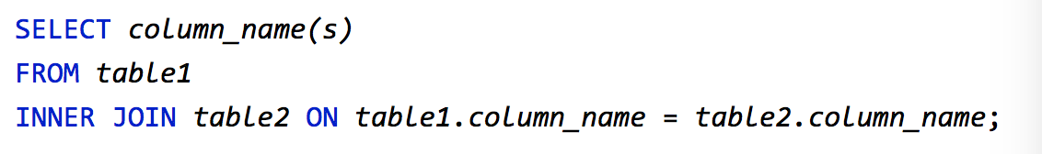
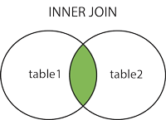
INNER JOIN
The INNER JOIN keyword selects records that have matching values in both tables.

Slide 44
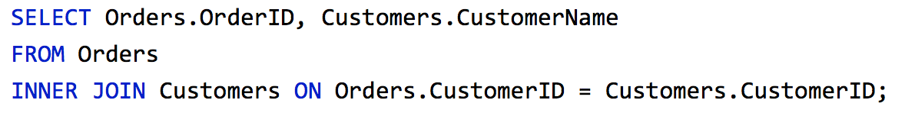
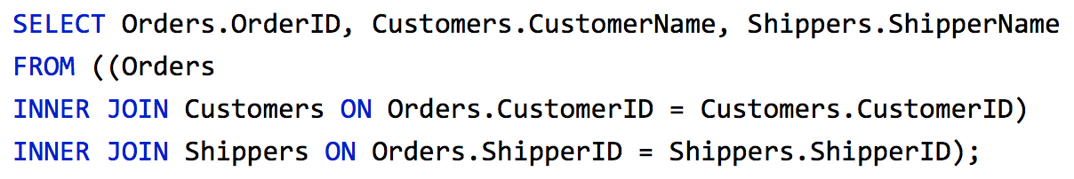
INNER JOIN: Examples

Slide 45
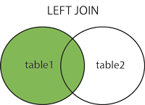
LEFT JOIN
The LEFT JOIN keyword returns all records from the left table (table1), and the matched records from the right table (table2). The result is NULL from the right side, if there is no match.
SELECT column_name(s)
FROM table1 LEFT JOIN table2 ON table1.column_name = table2.column_name;

Slide 46
LEFT JOIN:Example
SELECT Customers.CustomerName, Orders.OrderID
FROM Customers
LEFT JOIN Orders ON Customers.CustomerID = Orders.CustomerID
ORDER BY Customers.CustomerName;

Slide 47
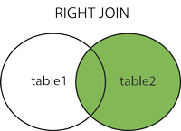
RIGHT JOIN
The RIGHT JOIN keyword returns all records from the right table (table2), and the matched records from the left table (table1). The result is NULL from the left side, when there is no match.
SELECT column_name(s)
FROM table1
RIGHT JOIN table2 ON table1.column_name = table2.column_name;

Slide 48
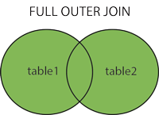
FULL OUTER JOIN
The FULL OUTER JOIN keyword return all records when there is a match in either left (table1) or right (table2) table records.
Note: FULL OUTER JOIN can potentially return very large result-sets!
SELECT column_name(s)
FROM table1 FULL OUTER JOIN table2 ON table1.column_name = table2.column_name;

Slide 49
SELF JOIN
A self JOIN is a regular join, but the table is joined with itself.
SELECT column_name(s)
FROM table1 T1, table1 T2
WHERE condition;
The following SQL statement matches customers that are from the same city:
SELECT A.CustomerName AS CustomerName1, B.CustomerName AS CustomerName2, A.City
FROM Customers A, Customers B
WHERE A.CustomerID <> B.CustomerID
AND A.City = B.City
ORDER BY A.City;

Slide 50
UNION
The UNION operator is used to combine the result-set of two or more SELECT statements.
Each SELECT statement within UNION must have the same number of columns
The columns must also have similar data types
The columns in each SELECT statement must also be in the same order
SELECT column_name(s) FROM table1
UNION SELECT column_name(s) FROM table2;

Slide 51
UNION : Example
SELECT City FROM Customers
UNION
SELECT City FROM Suppliers
ORDER BY City;
Note If some customers or suppliers have the same city, each city will only be listed once, because UNION selects only distinct values. Use UNION ALL to also select duplicate values!

